Slide 1
Team 18
Co-Creator
An AI Co-Creator for creatives and small business owners who want to turn their passion into sustainable revenue.
Notes:
© Microsoft Corporation. All rights reserved. MICROSOFT MAKES NO WARRANTIES, EXPRESS, IMPLIED OR STATUTORY, AS TO THE INFORMATION IN THIS PRESENTATION.
9/18/2025 10:24 AM
1

Slide 2
Most Creators Don't Fail Because Their Product Isn't Good
They fail because marketing is confusing, time-consuming, and doesn't translate into sales. Social engagement doesn't equal revenue, and every platform promises results without delivering real strategy.
Notes:
5

Slide 3




The Problem
Marketing Is Fragmented
Effort Doesn't Convert
Too many platforms, unclear priorities, constantly changing trends.
Likes ≠ customers. There’s no feedback loop connecting content to real sales or growth.
Time & Cognitive Overload
Local Opportunities Are Invisible
Repetitive marketing tasks lead to burnout and inconsistency. Creators spend more time managing tools than creating.
Events, fairs, and partnerships are scattered and hard to discover. High-conversion, in-person opportunities are often missed entirely.
Notes:
10

Slide 4
Imagine a Different Future
What If You Could Just Create?
Imagine focusing on your craft while an intelligent system handles your marketing. A clear, proven path from content to customers. Local and online marketing working together seamlessly.
This isn't a dream — it's what happens when AI becomes your marketing copilot.
Notes:
5

Slide 5
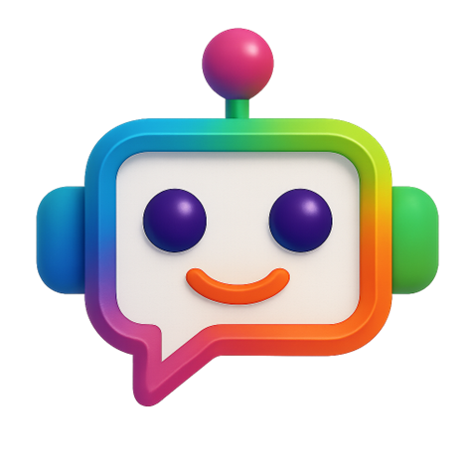
Introducing Your AI
Marketing Copilot: Co-Create
1
2
Context-Aware Strategy
Automated Execution
Our AI understands your business, goals, and audience to create personalized marketing plans.
Posts, emails, and outreach are created and scheduled automatically across all channels.
3
Continuous Learning
The system measures what converts and adapts your strategy in real-time for better results.
Notes:
5

Slide 6
How It Works
Input Your Context
1
Tell us about your business: goals, products, location, and target audience.
2
AI Generates Your Plan
Receive a tailored marketing strategy designed specifically for your creative business.
Automated Creation
3
Content and outreach are created and scheduled automatically across all channels.
4
Performance Tracking
Monitor what's working with clear metrics tied to revenue, not just vanity metrics.
Continuous Optimization
5
AI adapts your strategy based on real results, constantly improving performance.
Think of it as marketing agents working 24/7 while you focus on creating.
Notes:
7

Slide 7
AI Agents
A breakdown of our architecture.
Strategy Agent
Content Agent
Execution Agent
  Platform prioritization
  Posting cadence
  Revenue-aligned goals
  Platform-specific posts
  Emails and outreach
  Brand-aligned tone
  Scheduling
  Email sequences
  Follow-ups and reminders
Analytics Agent
Local Opportunity Agent
  Tracks conversions
  Explains what works
  Adjusts strategy automatically
  Finds nearby events and fairs
  Matches by business type
  Surfaces high-conversion channels
Notes:
4

Slide 8




The Impact
Less Time Guessing
Consistent Income
Stop wondering what to post or where to advertise. Our AI handles strategy so you can focus on creating.
Transform marketing from a cost center into a predictable growth engine that brings in paying customers.
Clear Visibility
Focus on Your Craft
Finally understand what actually works with metrics tied to revenue, not just engagement.
Do what you do best — create amazing work. Let AI handle the marketing that turns your art into income.
Notes:
9

Slide 9




Every Creator Deserves a Marketing Team
Our Vision
Our Mission
Join Us
A world where every creator has access to professional marketing powered by AI
Building the first true marketing copilot that turns effort into revenue
We're taking the first step toward that future — and we'd love your questions
Notes:
10

